Slide 1
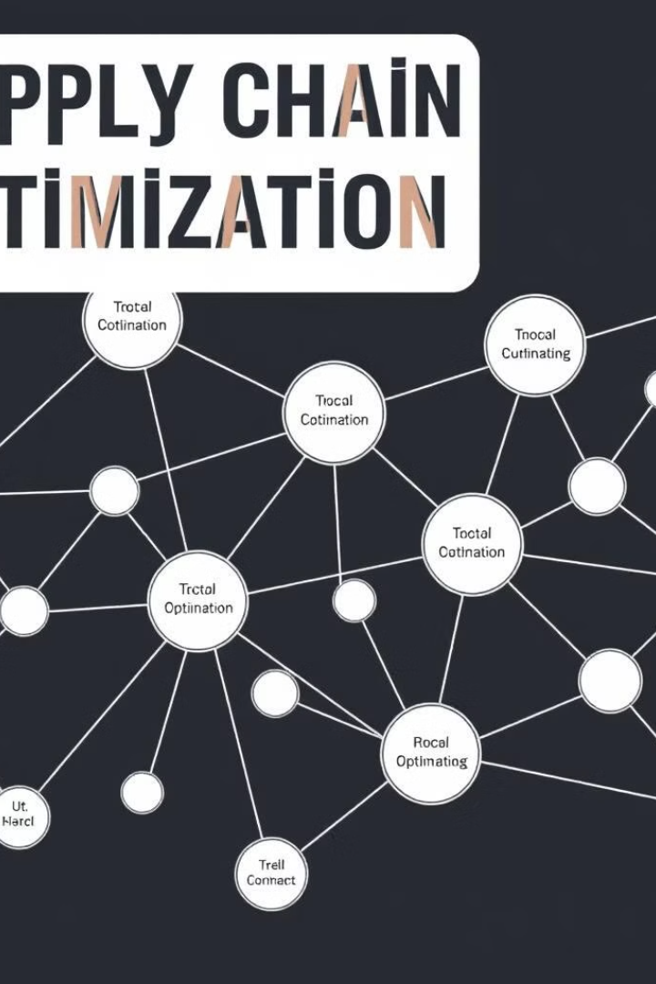
Optimization in Supply Chain Management
Supply Chain Management (SCM) coordinates the flow of goods, services, and information from origin to consumption. It aims to optimize processes, ensuring efficiency and customer satisfaction. SCM involves sourcing materials, manufacturing products, transporting goods, and managing inventories.

Slide 2





SCM Areas and Components
Planning
Sourcing and Procurement
Ensures efficient flow of goods and services through strategic, demand, and supply planning.
Focuses on acquiring goods and services from external sources to meet operational needs.
Manufacturing and Production
Logistics and Distribution
Manages the movement and storage of goods to ensure timely and cost-effective delivery.
Transforms raw materials into finished goods, ensuring efficiency and quality standards.

Slide 3

SCM Example: T-Shirt Production
1
Sourcing Raw Materials
The company sources high-quality cotton from suppliers at competitive prices.
2
Manufacturing
Cotton is transformed into T-shirts at the manufacturing plant, ensuring efficiency and quality control.
3
Transportation and Distribution
Finished T-shirts are transported to warehouses and retail stores, optimizing logistics for timely delivery.
4
Sales and Customer Service
T-shirts are sold to customers, with sales data used to forecast future demand.

Slide 4

Importance of Optimization
Cost Reduction
Efficiency Improvement
Identifies efficient routes, inventory levels, and production schedules to minimize operational costs.
Streamlines operations to reduce waste and enhance productivity across the supply chain.
Customer Satisfaction
Sustainability
Ensures timely delivery and high service levels through optimized logistics and distribution.
Reduces environmental impact by optimizing resource usage and transportation methods.

Slide 5
Types of Optimization Techniques
Deterministic Optimization
Stochastic Optimization
Robust Optimization
Uses known parameters and follows predefined rules. Examples include EOQ model, linear programming and critical path analysis.
Incorporates randomness and uncertainty. Techniques include Monte Carlo simulation and simulated annealing.
Creates solutions that remain valid under various scenarios. Used for uncertain demand or supply fluctuations.

Slide 6
Applications of Optimization
1
Inventory Optimization
2
Transportation Routing
3
Production Scheduling
Economic Order Quantity (EOQ) Model
Linear Programming Model (min cost)
Greedy Algorithms for Scheduling
ABC Analysis
Vehicle Routing Problem (VRP)
Simulated Annealing (SA)
(s, Q) Inventory Model (Reorder Point Model)
Local Search Algorithms
Network Flow Models
Resource Allocation
Single-Period Model (Newsvendor Model)
Hub-and-Spoke Network Optimization
Critical path Analysis for production process
Multi-Echelon Inventory Optimization
Heuristic and Metaheuristic Approaches

Slide 7
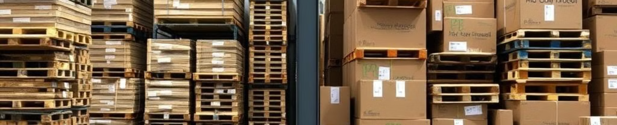
Case Study: Inventory Management
Challenge
High inventory costs and frequent stockouts
Solution
Implemented EOQ, Reorder Point optimization using Power BI
Results
50% reduction in stockout rate, improved inventory turnover

Slide 8
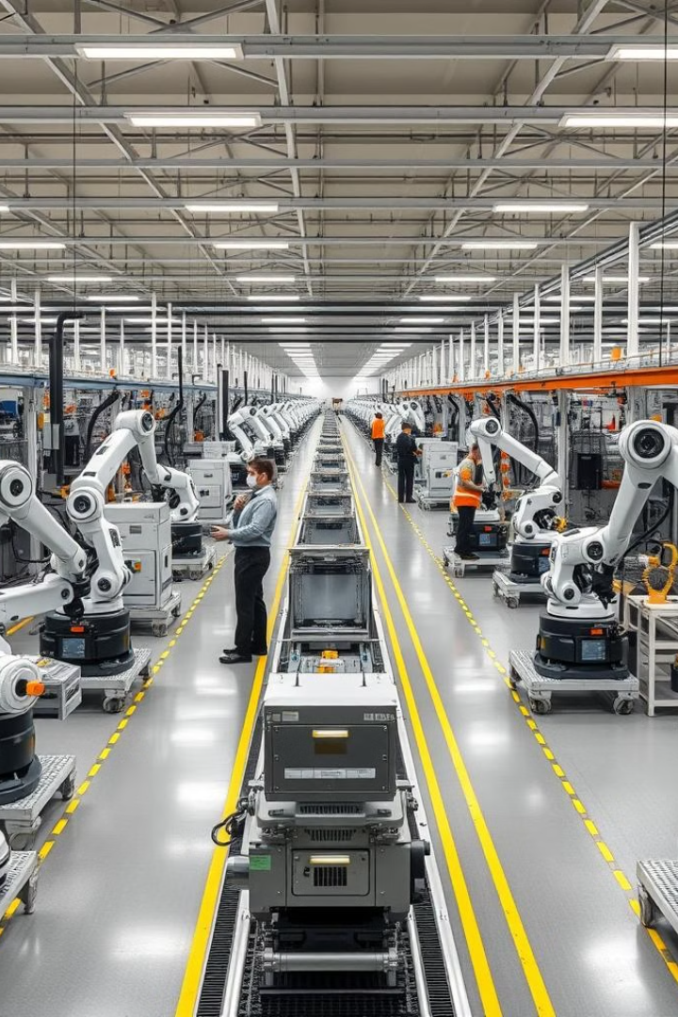
Case Study: Production Distribution
Challenge
Inefficient production capacity to meet customer demand
Solution
Optimized capacity using LPP/IPP techniques and Power BI
Results
99% production capacity utilization, improved demand fulfillment

Slide 9

Questions and Quiz

